Slide 1
INTELLIGENT SYSTEMS · Tutorial 1
Introduction to Intelligent Systems
Dan Su

Slide 2
Contact
Email: dan.su@cityu.edu.hk

Slide 3
Question
Name one “intelligent” system you used today.
Maps / navigation
Spam filter
Voice assistant
Recommendations
Autocorrect / chat AI

Slide 4




What Do We Mean by “Intelligence”?
A classic way to organize definitions of AI — along two axes: what we imitate, and what we optimize for.
Thinking Humanly
Thinking Rationally
Modeling human cognition (cognitive science)
Formal logic and correct inference (“laws of thought”)
Acting Humanly
Acting Rationally
Behavior indistinguishable from a person (Turing Test)
Choosing actions that best achieve goals

Slide 5




What Is an Intelligent System?
A system that perceives its environment through sensors, reasons about what it perceives, and acts upon that environment through actuators to achieve its goals — improving its behavior with experience.
Perception
Reasoning
Action
Adaptation
Autonomy
Sensing raw data from the environment
Interpreting percepts, weighing options
Executing decisions via actuators
Learning from feedback over time
Operating with limited direct oversight

Slide 6


Can a Machine Think?
The Turing Test (1950)
The Chinese Room (Searle, 1980)
If a human judge cannot reliably tell a machine's text responses from a person's, the machine may be said to “think.”
A person following a rulebook can produce fluent Chinese answers without understanding Chinese — so symbol manipulation ≠ understanding.
BEHAVIORAL TEST — JUDGES BY OUTPUT
PHILOSOPHICAL OBJECTION — QUESTIONS MEANING

Slide 7
Six Decades of AI: A Bird's-Eye View
1956 to today — AI has advanced in repeated waves, and is now moving toward the era of “strong AI.”
The formal model of computation
ENIAC — hardware catches up to theory
Rule-based knowledge engineering, Phase 2
Hinton's breakthrough opens Phase 3
Brain-inspired, general-purpose systems
1936
1946
1976
2006
2030s
Turing Machine
First Computer
Expert Systems
Deep Learning
Toward Strong AI
1943
1956
1998
2017
Turing's “Brain”
“AI” Is Coined
Semantic Web
Transformers
First neuron model (McCulloch & Pitts)
Dartmouth Conference, Phase 1 begins
Berners-Lee links information by meaning
The architecture behind today's LLMs

Slide 8



Three Drivers of Modern AI
Data
Compute
Algorithms
Massive labeled and unlabeled datasets from the web, sensors, and users
GPUs, TPUs, and cloud-scale infrastructure enable training at scale
Deep learning and transformer architectures unlock new capabilities

Slide 9
KEY VOCABULARY
■
Neural Networks
Artificial neurons arranged in connected layers that learn patterns from data
■
Expert Systems
Decision making through if-then rules
■
Machine Learning
Improving performance from data and experience
■
Deep Learning
Neural networks with multiple layers for complex patterns
■
Fuzzy Systems
Reasoning with approximate and uncertain information
■
Evolutionary Computation
Search methods inspired by natural evolution and selection

Slide 10

PARADIGM 1
Neural Networks
Artificial neurons arranged in connected layers that learn patterns from data
How It Works
Strengths
Limitations
✓ Elegant mathematical foundation (energy-based)
✓ Completes incomplete/ noisy patterns
✓ Biologically inspired (mirrors neural activity)
✓ Guaranteed convergence
✗ Limited storage capacity (0.138N patterns for N neurons)
✗ Small network size practical limit
✗ Impractical for large-scale problems
Fully connected neurons with feedback loops. Energy function guides to stable states. Updates converge to attractors

Slide 11
PARADIGM 2
Expert Systems
Decision making through if-then rules
How It Works
Strengths
Limitations
Human experts encode their knowledge as rules: "IF condition THEN action"
✓ Explainable (you can see why it made a decision)
✓ Reliable on familiar cases
✓ Low data requirements
✗ Does not scale — too many rules to maintain
✗ Brittle — fails outside programmed scenarios
✗ Cannot learn

Slide 12

PARADIGM 3
Machine Learning
Improving performance from data and experience
How It Works
Strengths
Limitations
Feed the system data + examples. It learns patterns automatically, no rules needed.
✓ Discovers hidden patterns humans don't see
✓ Adapts to new data
✓ Powers modern AI (recommendations, vision, NLP)
✗ Needs lots of labeled data
✗ "Black box" — hard to explain why it decided something
✗ Can learn the wrong patterns

Slide 13
PARADIGM 4
Deep Learning
Neural networks with multiple layers for learning complex patterns
How It Works
Strengths
Limitations
Stacked layers of artificial neurons process data through learned transformations, extracting increasingly abstract features
✓ Learns from raw data (no handcrafted features)
✓ Scales to massive datasets
✓ Exceeds human performance on many tasks
✗ Requires enormous labeled data
✗ Black box—hard to explain decisions
✗ Demands significant compute power

Slide 14
PARADIGM 5
Fuzzy Systems
Reasoning with approximate and uncertain information
How It Works
Strengths
Limitations
Uses fuzzy sets and membership functions where values range from 0 to 1 (instead of just 0 or 1), combined with if-then rules
✓ Handles uncertainty naturally
✓ Models human-like reasoning
✓ Combines with expert rules easily
✗ Requires manual design of membership functions
✗ Scales poorly with many variables
✗ Cannot learn from data automatically

Slide 15

PARADIGM 6
Evolutionary Computation
Search methods inspired by natural evolution and selection
How It Works
Strengths
Limitations
Create random candidates, test them, keep the best, mutate and repeat. Survival of the fittest.
✓ No training data needed
✓ Finds novel solutions humans wouldn't think of
✓ Good for optimization and design
✗ Slow — lots of iterations needed
✗ Can get stuck in local optima
✗ Hard to predict or control

Slide 16





Intelligent Systems
Applications of Intelligent Systems
Autonomous Robots
Natural
Language Processing
Sentiment Analysis
Robots that perform tasks on their own without human control.
Computers understand human language automatically.
Detects emotions in text content.
Computer Vision
Expert Systems
Technology that enables computers to see, interpret, and understand images or videos.
Mimic human expert decision-making.

Slide 17
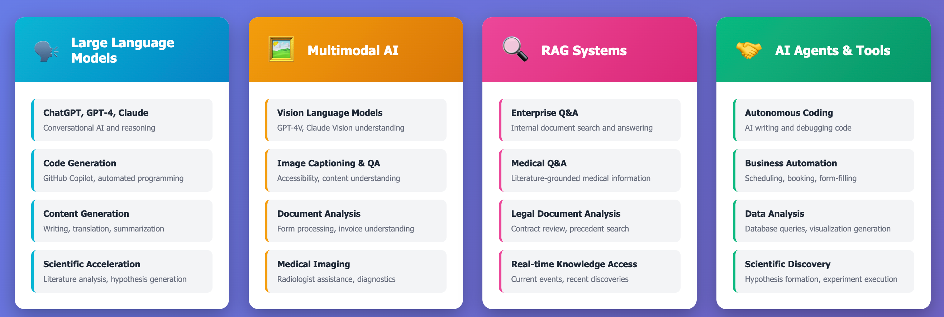
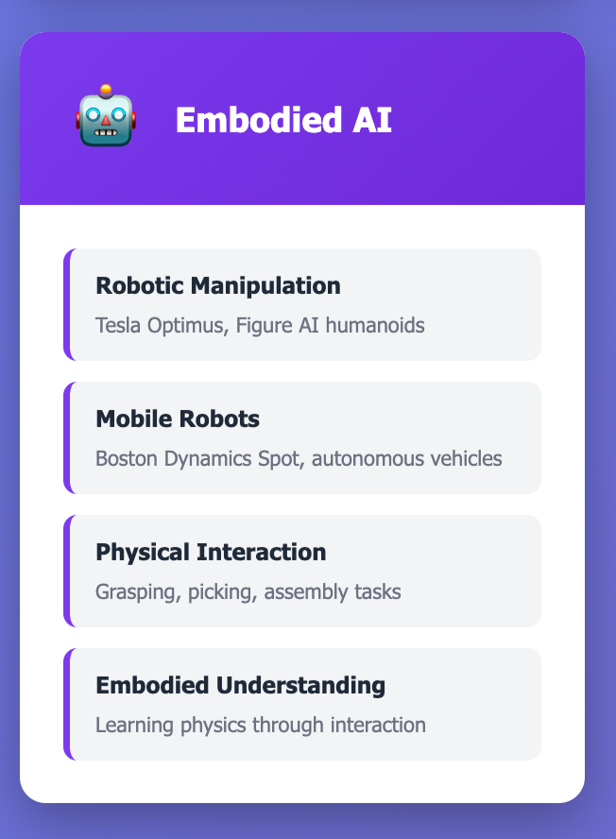
Latest AI Technologies & Applications
A comprehensive guide to cutting-edge AI systems and their real-world uses

Slide 18
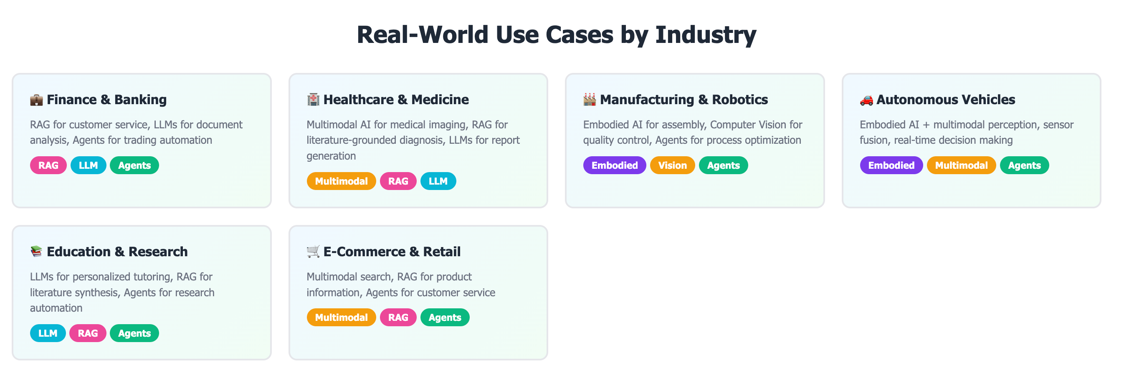

Slide 19
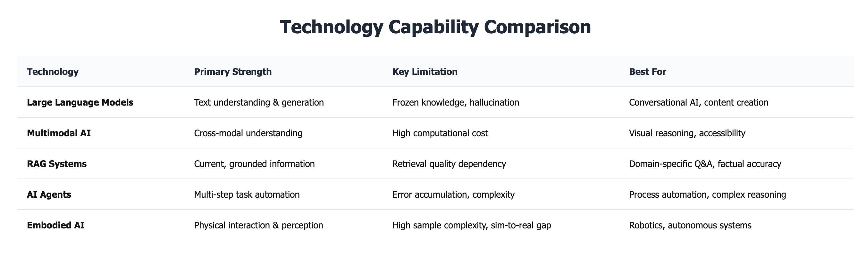

Slide 20
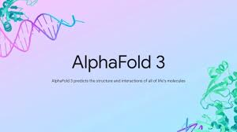
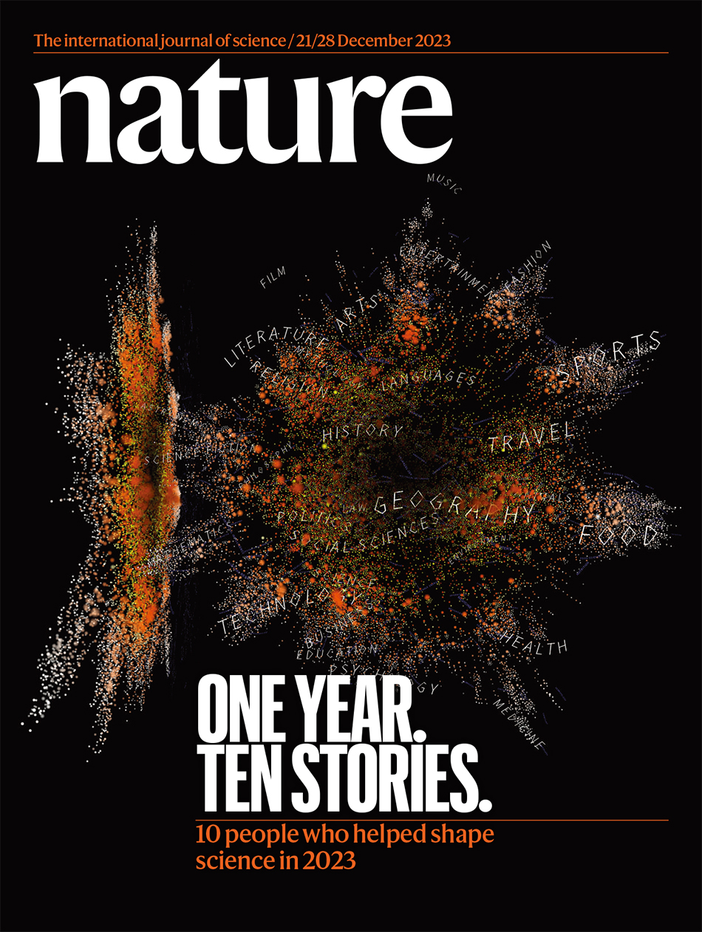
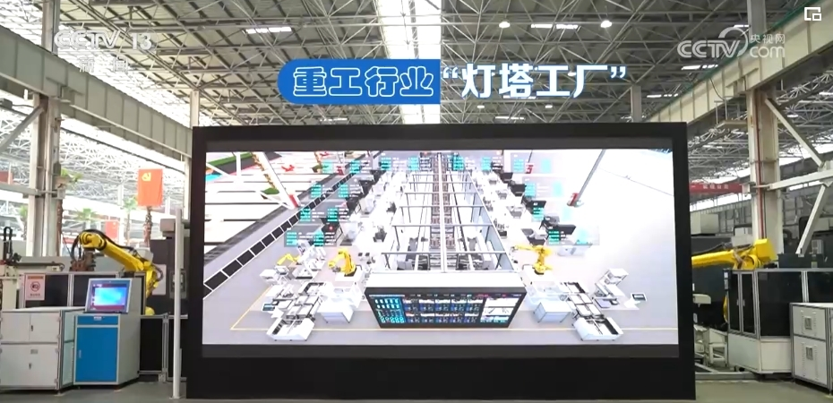
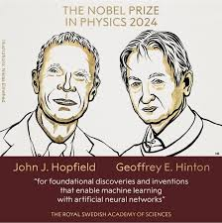
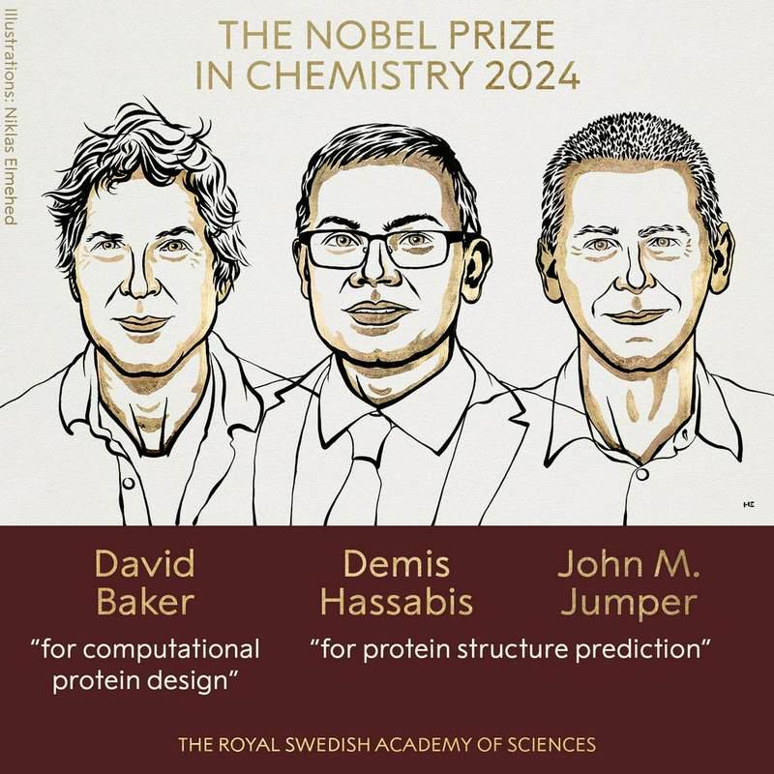
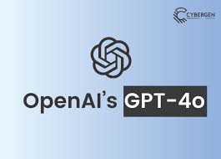
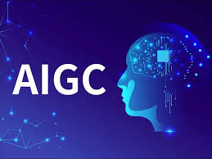
AI for Science
AI for Society
• AlphaFold Breakthrough
ChatGPT ranked among Nature's top 10 scientists of the year
Manufacturing 4.0
AI large models becoming the engine of the Fourth Industrial Revolution
AI large models driving the "Fifth Scientific Research Paradigm" revolution
AI technology achieved significant breakthroughs in physics and chemistry
MultimoGPT-4o
Content Creation

Slide 21
Thank You

